Slide 1



How Boston Scientiﬁc Improves
Manufacturing Quality Using
Graph Analytics
波士顿科学公司使用图数据库
提升制造质量管理
GraphAware
®

Slide 2
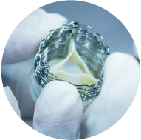

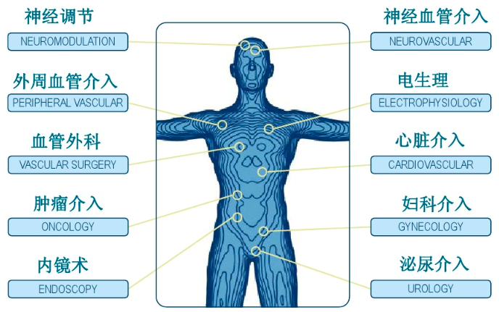
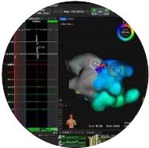
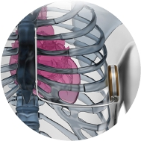

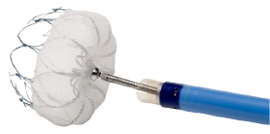

Boston Scientific波士顿科学公司简介
作为全球医疗技术行业创新领导者，波士顿科学2013年研发投入资金达8.61亿美金，在世界范围内拥有超过16,000项授权专利。公司总部设在美国马萨诸塞州波士顿地区的内提克市，全球共有约23,000名员工，业务遍及全球各个国家。2019年度，波士顿科学实现年度营业收入90亿美元，财富500强排名319位。
®

Slide 3


THEME 1视角1
FOCUS ON THE BUSINESS PROBLEM
关注业务问题

Slide 4
THEME 2视角2
USE THE RIGHT TOOLS
使用正确的工具

Slide 5
THEME 3视角2
KEEP IT SIMPLE
保持简单

Slide 6

Boston Scientific:
A Case Study in Graph Adoption使用图数据库的历程
‣
‣
‣
‣
‣
‣
‣
Business problem存在业务问题
Discover graphs发现图数据库技术
Exploration, vetting of technology调研，评估技术路线
Proof of concept (PoC) / Minimum Viable Product (MVP)原型验证/最小变量产品
Success & business value demonstrated业务价值体现
Evaluate additional business opportunities评估后续业务机会
Repeat循环重复
GraphAware
®

Slide 7
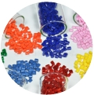

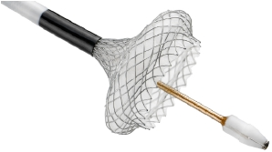
Business Problem & Use Case业务问题及用例
What caused a failure?
+
‣
‣
‣
‣
‣
Vertically integrated纵向关联集成
Batch processing批次业务特点
Multiple teams多团队
Nonstandard analysis methods非标准分析方法
Lots of spreadsheet manipulation大量使用电子表格
GraphAware
®

Slide 8




Supply Chain Mapping供应链过程匹配
Part
Part A
Qty: 100
Iss
75
ue
Part
d
Issued
25
Product
Qty: 100
Results In
Failure
Qty: 1
Part B
Qty: 100
Part
Part C
®

Slide 9
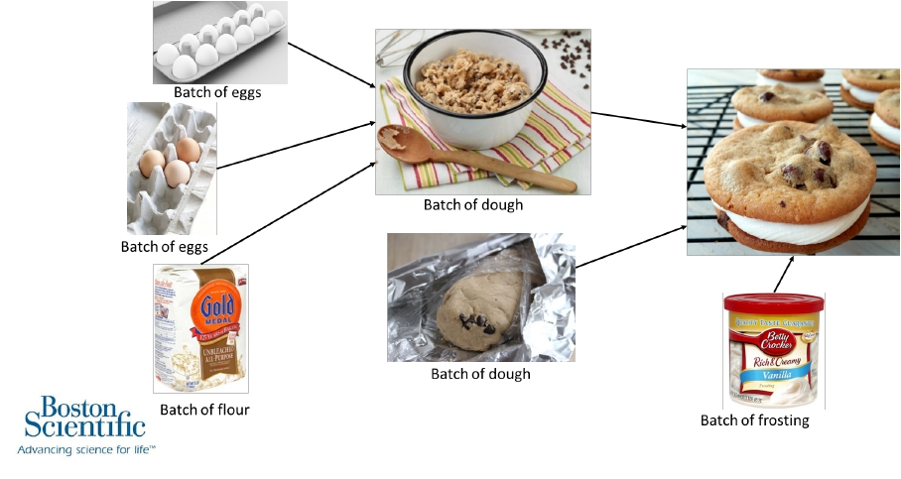
Analogy打个简单比方
鸡蛋批次
鸡蛋批次
面团批次
面团批次
面粉批次
糖霜批次
GraphAware
®

Slide 10
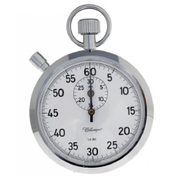
Graphs Add Business Value:图技术的业务价值
Performance效率
‣
‣
‣
Query times decreased from ~ 2+ minutes to ~ 10-55 seconds缩短查询时间
Streamlines the process整合流程
Enhances overall eﬃciency提高整体效率
GraphAware
®

Slide 11
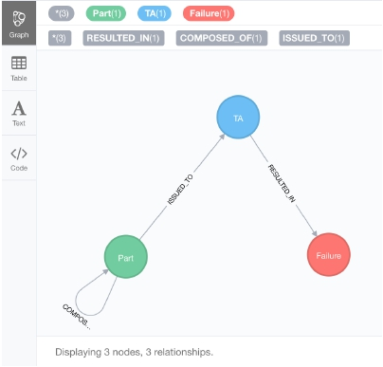
Graphs Add Business Value增加业务价值
Largest value added from non-functional areas:非功能领域
‣
‣
‣
‣
Simplicity简单
Explainability可解释
Whiteboard friendly白板友好性
Data Accessibility数据可及性
GraphAware
®

Slide 12
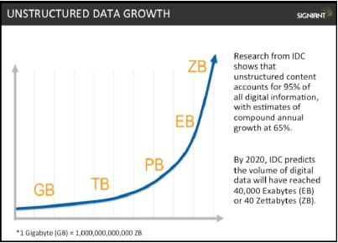
Graphs Add Business Value:
Data Accessibility数据可及能力
Estimates:
‣
‣
2.5 quintillion bytes of data created daily, accelerating
90% of the world’s data generated in the last 2 years
GraphAware
®

Slide 13
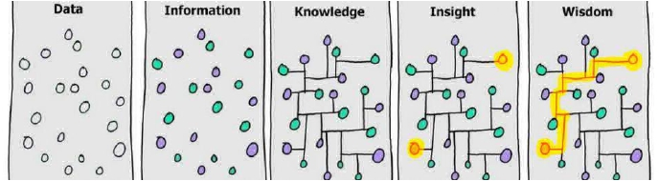
Graphs Add Business Value:
Data Accessibility
数据
信息
知识
经验
智慧
Everyone has data
The competitive advantage
is going from data to
wisdom to action
GraphAware
®

Slide 14
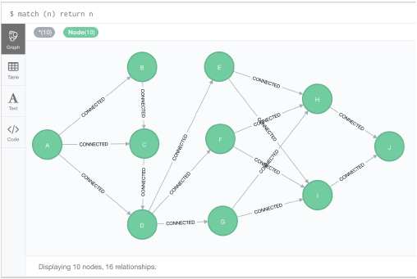
Graphs Add Business Value:
New Capabilities新功能
‣
‣
Shortest path最短路径
Variable length queries距离长度变量查询
GraphAware
®

Slide 15
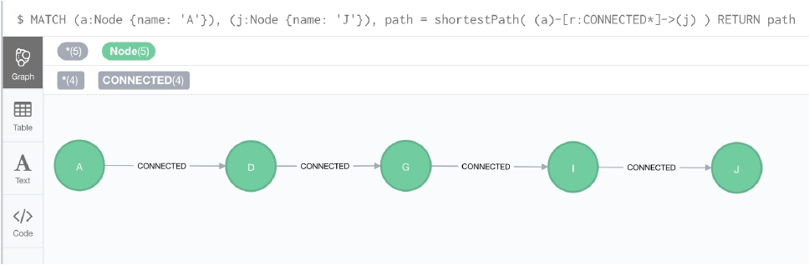
Shortest Path: Cypher最短路径
GraphAware
®

Slide 16
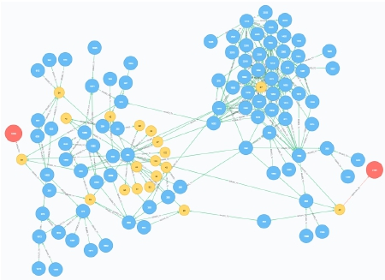
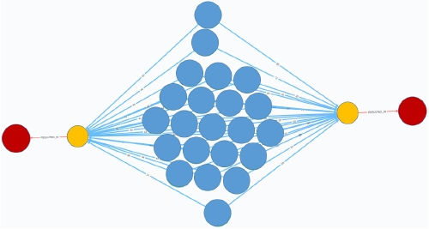
Boston Scientific: Shortest Path最短路径
Links between failures质量问题直接的关联性
GraphAware
®

Slide 17
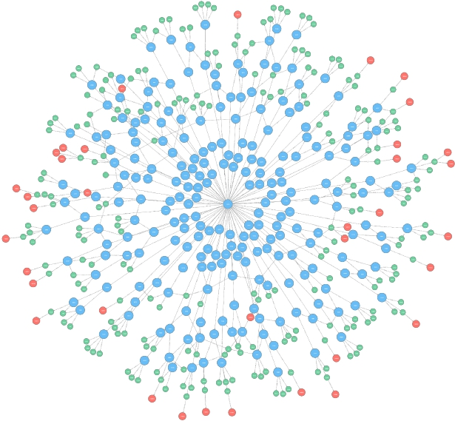
Looking for patterns
can lead to scary
graphs…
查看（质量问题发生的）模式特征，会导致恐怖的网状图结构
GraphAware
®

Slide 18
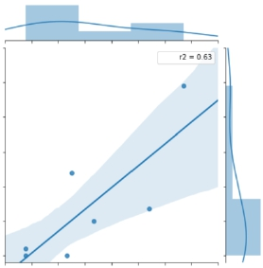
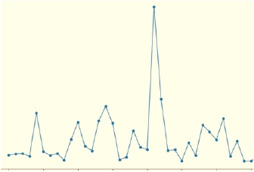
Extract and Analyze Graph Data抽取和分析图数据
‣
‣
Every batch (node) gets a “score”每一个批次都有一个权重数
Scores can be analyzed in a number of way权重以多种方式分析
Score
Score
Date
Process Data
GraphAware
®

Slide 19

Extract Insights From the Graph从图中洞悉问题所在
‣
Prepare data
Python
Part A
Issu
75
:
5
Issu
Wei
0.25
We
ed:
‣
‣
Build and test database
py2neo/cypher
Augment properties
Weights and scores
ight
0.7
Product
Qty: 100
Failure
ed: 25
ght:
Part B
…then develop a production-worthy pipeline through Hadoop:
®

Slide 20
BOSTON SCIENTIFIC NEXT STEPS
Data Model Evolution数据模型演进

Slide 21
Graph Adoption Lessons经验教训
Many start by transfer existing data model to the graph 1:1按照一对一的方式导入数据
‣
‣
‣
This approach is ok when getting started开始是可以的
Follows crawl, walk, run遵循爬、走、跑的原则
May not take advantage of graph strengths但是不能发挥图数据库的优势
Graphs are highly ﬂexible, easy to change图数据库的特点就是高度灵活，易于变更
‣
‣
‣
Many accustomed to high barriers and costs of changes in non-graphs，Leads to the “Mentality of initial perfection”非图数据库的方法，面对需求变更，开发代价非常大。非图数据库的方法论是“设计开始就要完美”
Avoid this mentality and revise, evolve model easily, as needed
应当避免这种局限思维，而遵循按照业务需求进行不断的变更、进化的做法
GraphAware
®

Slide 22
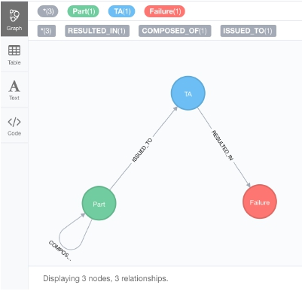
Boston Scientific:
Graph Model Evolution图数据模型的调整优化
‣
‣
TopAssembly (TA) has a “product” text property顶级产品有一个属性叫“产品”
Next: extract “product” to dedicated node, relationship 后来，抽取出“产品”为一个特定节点和关系（边）
GraphAware
®

Slide 23
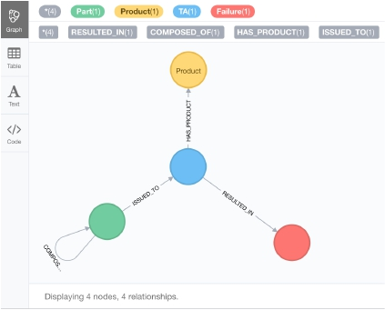
Graph Model Evolution图数据模型的调整优化（三行代码而已）
match (ta:TA) with ta
create (:Product {name: ta.product})-[:HAS_PRODUCT]->(ta)
remove ta.product
GraphAware
®

Slide 24
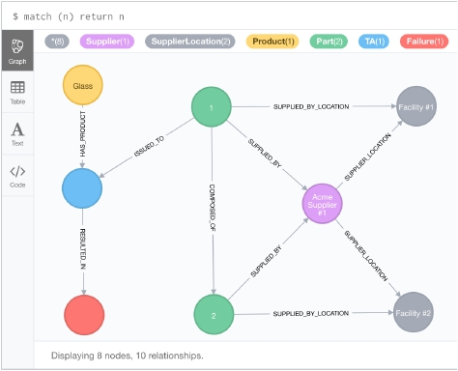
Boston Scientific:
Graph Model Evolution图数据模型的调整优化（扩展）
Data analysis expansion
add supplier and supplier facility data
增加供应商和供应地数据
GraphAware
®

Slide 25

Connecting Different Products关联不同的产品
‣
‣
‣
Apply ﬁndings from existing products to new ones查找已有产品中查找新产品的关联度
Alert other internal users of suspicious raw material batches more quickly向内部用户警示某个可疑批次原材料
Improve sensitivity to weak signals强化弱信号的敏感度
New Product
Failure
Failure
Raw Material
Product
Part
Part
GraphAware
®

Slide 26
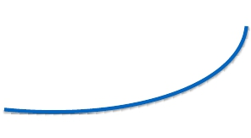


NLP Use Cases未来自然语言处理的使用
• Import raw text describing inspection failures 从质量问题报告导入文本数据
• Extract and correlate topics for better root cause抽取相关主题以更直观的找到问题根源
investigation细化调查
属于
Topic 1
主题1
属于
in
s to
Per
rta
t in
Pe
a
s to
主题1的热度
Event 1
事件1
Event 2
事件2
Per
Part
tains
to
属于
Topic 2
主题2
时间
GraphAware
®

Slide 27

GraphAware
®

Slide 28
Thank You
Questions?
GraphAware
®

